Slide 1
AI的普科篇 General Science of Artificial Intelligence

Slide 2
目錄 Table of Contents
108科技資訊課綱的背景 Background of 108 STEM Guideline
工業 4.0 4.0 Industry 4.0
大數據，物聯網 和人工智能，Big Data，ＩＯＴ， and Artificial Intelligence
AI的深度學習 Artificial Intelligence, Deep Learning
深度學習的應用 Applications of Deep Learning
自駕 Auto Self Drive
強化學習 Reinforcement Deep Learning
認識最新AI對未來產業的影響 acknowledge the AI influence to future
國中 、國小的資訊學習目標STEM study goals of middle school and elementary school students
擴展視野 expand world viewpoint
培養對程式設計興趣 encourage the student’s programming interests
促進自行解決問題的能力 promote problem solving ability
養成終身學習的習慣 retain long life study habit
備註: 國小低年級，一、二年級，以遊戲設計、機械人DIY為主。
Remark: the major content of low grade elementary school students will focus on programming game design, and robot DIY

Slide 3
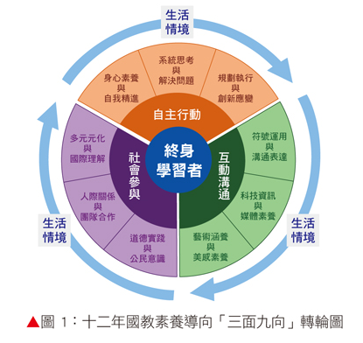
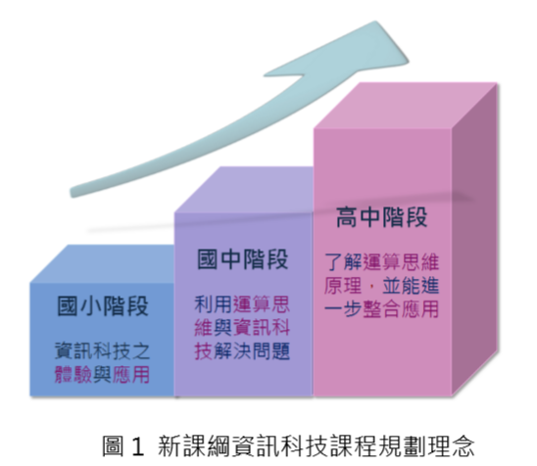
108科技資訊課綱的背景 Background of 108 STEM Guideline
集注
Remark: STEM, Science, Technology, Engineering, Mathematics

Slide 4
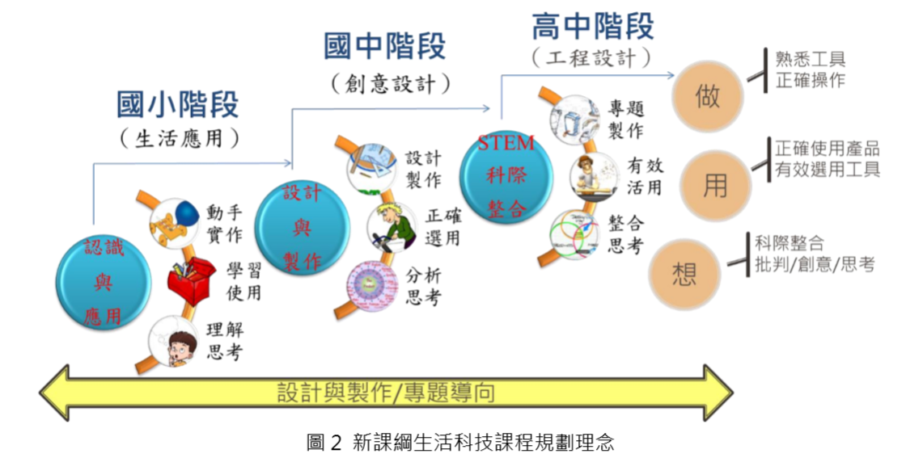
108科技資訊課綱的背景 Background of 108 STEM Guidelinｅ

Slide 5
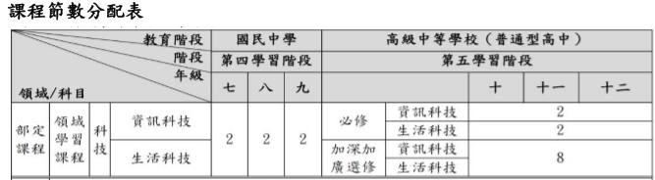
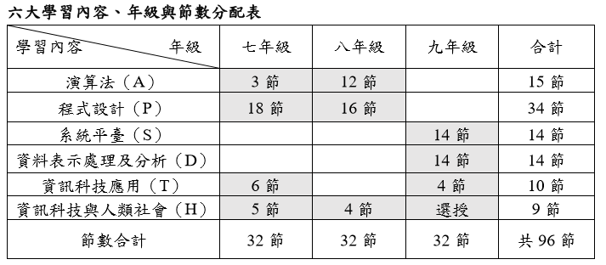
臺北市科技領域國中資訊科技教學綱要 Ｔａｉｐｅｉ Ｍｉｄｄｌｅ Ｓｃｈｏｏｌ ＳＴＥＭ Ｃｏｎｔｅｎｔｓ／Ｇｕｉｄｅｌｉｎｅ

Slide 6
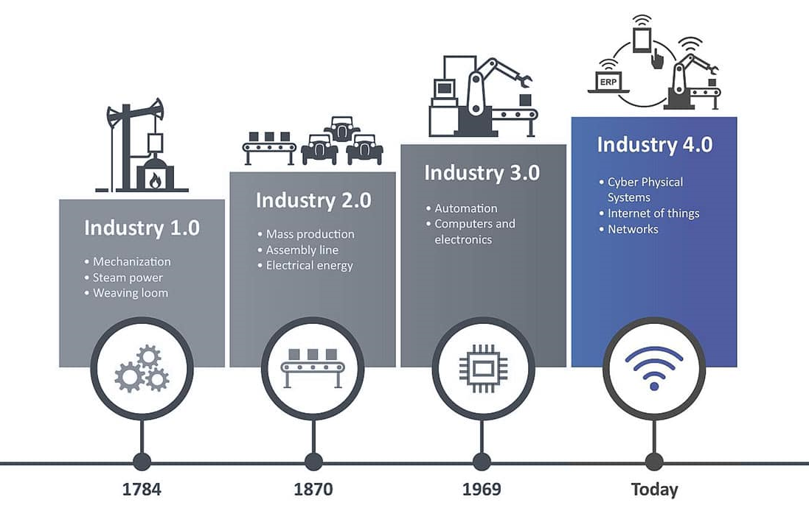
工業 4.0 Industry 4.0
1784 蒸汽動力 Steam Power
1870 電力 Electrical Power
1969 自動化，電腦, 電子產品 automation, computer, electronics
當前 物聯網, 大數據, 深度學習Present, IOT, Big Data, Deep learning,

Slide 7
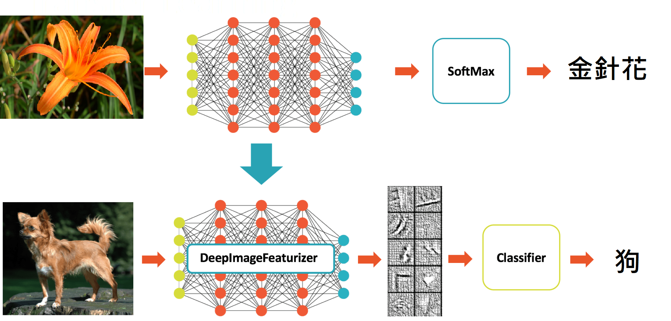
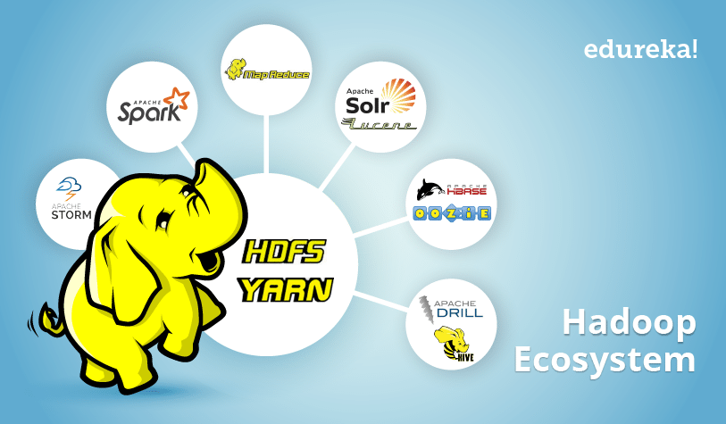
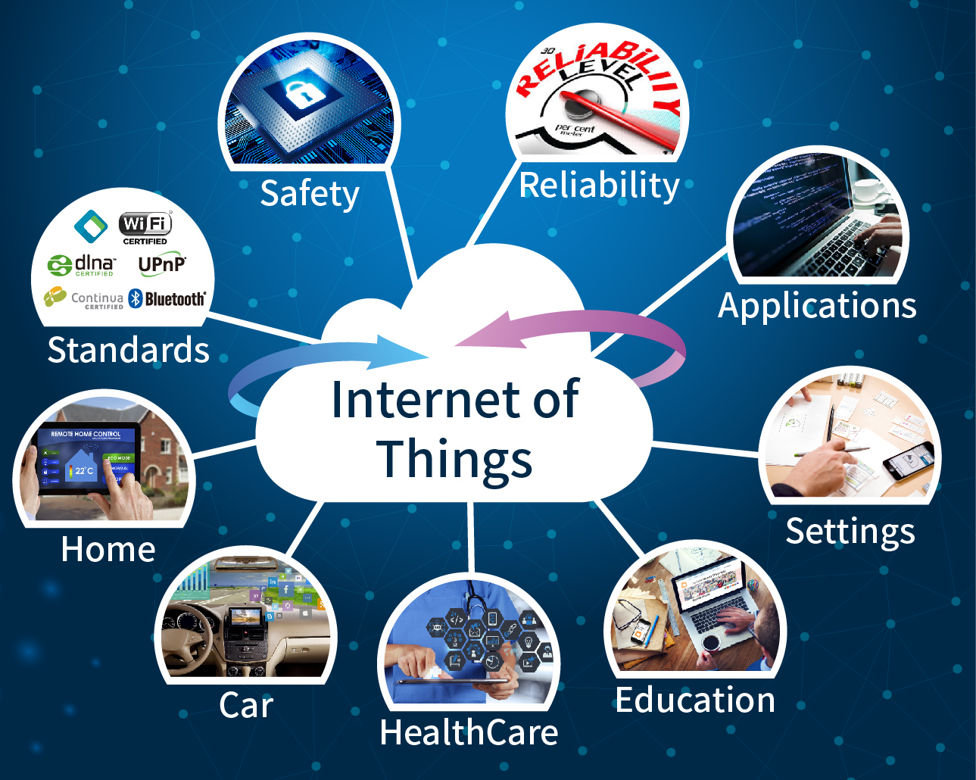
大數據, 物聯網, 人工智能 Big Data, IOT, and Artificial Intelligence
大數據 Big Data
深度學習 Deep Learning
物聯網 IOT

Slide 8
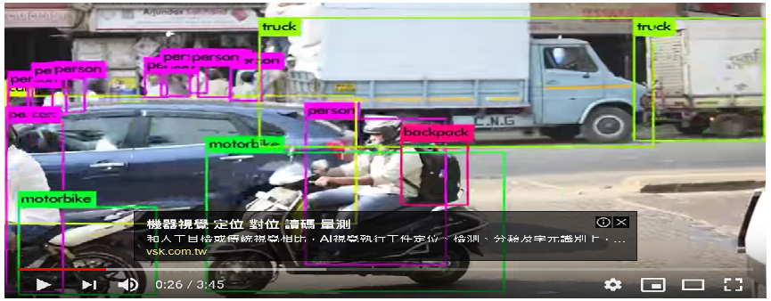
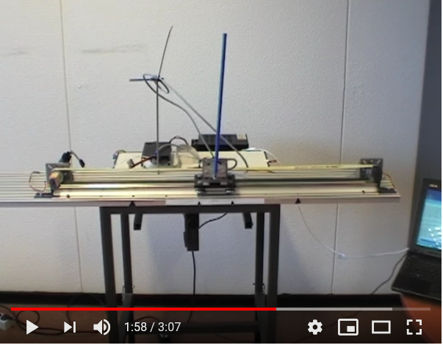
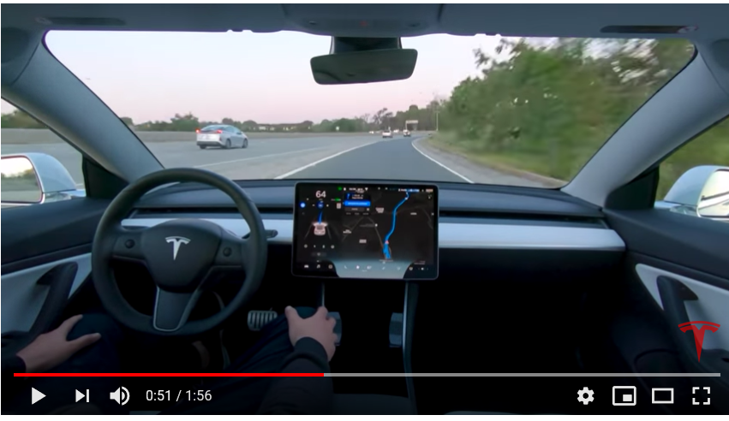
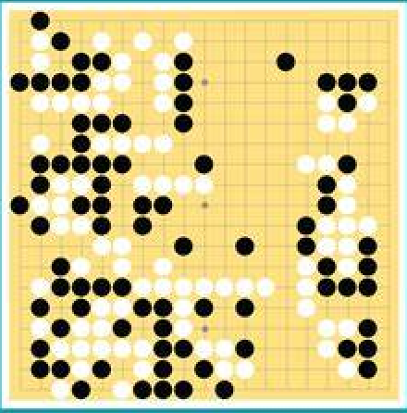
深度學習的應用 Applications of Deep Learning
自駕 Auto Self Drive
強化深度學習
Reinforcement Deep Learning

Slide 9
認識最新AI對未來產業的影響 Acknowledge AI influence to future
深度學習AI的應用將滲透到我們常規生活 Applications of Deep learning AI will penetrate to our regular life
富人，中產階級和窮人的比率正在發生巨大變化 Ratios of Rich, Middle class and Poor is changing dramatically
富士康將在未來幾年內減少50萬個工作崗位 Foxconn will eliminate half million jobs for next few years
沒有新的技能，工資將受到限制 Without new skillset, the salary will be limited
您如何設定未來的學習目標 How do you set your goals of future study

Slide 10
國中 、國小的資訊學習目標 STEM study goals of middle school and elementary school students
擴展世界觀 expand world viewpoint
培養對程式設計興趣 encourage the student’s programming interests
促進自行解決問題的能力 promote problem solving ability
養成終身學習的習慣 retain develop long life study habit

Slide 11
Ｂａｃｋｕｐ

Slide 12
ＵＲＬｓ
Self drive
https://www.youtube.com/watch?v=tlThdr3O5Qo
Yolo
https://www.youtube.com/watch?v=MPU2HistivI
Cart-Pole britch
https://www.youtube.com/watch?v=Lt-KLtkDlh8

Slide 13
